Slide 1






Slide 2



HTTP
Shopping cart
UI
Web Server

Slide 3
HTTP
Shopping cart
UI
Web Server
WebSockets

Slide 4

HTTP
Shopping cart
UI
Web Server
WebSockets

Slide 5

What value does the Web Server add, anyway?

Slide 6
HTTP
Shopping cart
UI
Web Server
WebSockets

Slide 7
HTTP
Shopping cart
UI
WebSockets

Slide 8
HTTP
UI
Shopping cart

Slide 9
UI
Shopping
cart
UI

Slide 10
HTTP
Shopping cart
UI

Slide 11
HTTP
Shopping cart
Batch job
UI

Slide 12
HTTP
Shopping cart
Shopping cart
Shipping
UI

Slide 13
HTTP
HTTP
Shopping cart
Shipping
UI

Slide 14
HTTP
HTTP
Shopping cart
Batch job
Shipping
UI

Slide 15
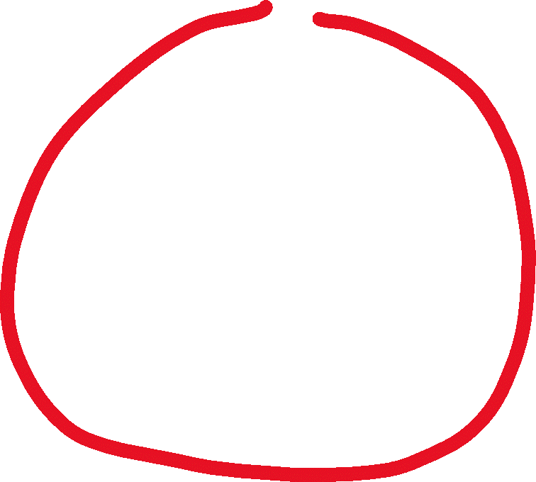
HTTP
HTTP
Shopping cart
Shopping cart
Batch job
Batch job
Shipping
UI

Slide 16

So you decided to build a poor pony’s queue?

Slide 17


HTTP
HTTP
Shopping cart
Batch job
Shipping
UI

Slide 18

I can see a pattern here…

Slide 19
HTTP
Shopping cart
Shipping
UI
UI

Slide 20
Sync
Async
Shopping cart
Shipping
UI

Slide 21

How are you going to send a message and update DB in a transaction?

Slide 22
So you DID decide to build a poor pony’s queue?

Slide 23
NServiceBus.Router
Qpid Dispatch

Slide 24
Shopping cart
Shipping

Slide 25
Shipping

Slide 26
Let’s use events!

Slide 27

No! Let’s use commands!

Slide 28
How does your app service know what message to send?

Slide 29

You ruined my encapsulation!

Slide 30
Domain Events?

Slide 31
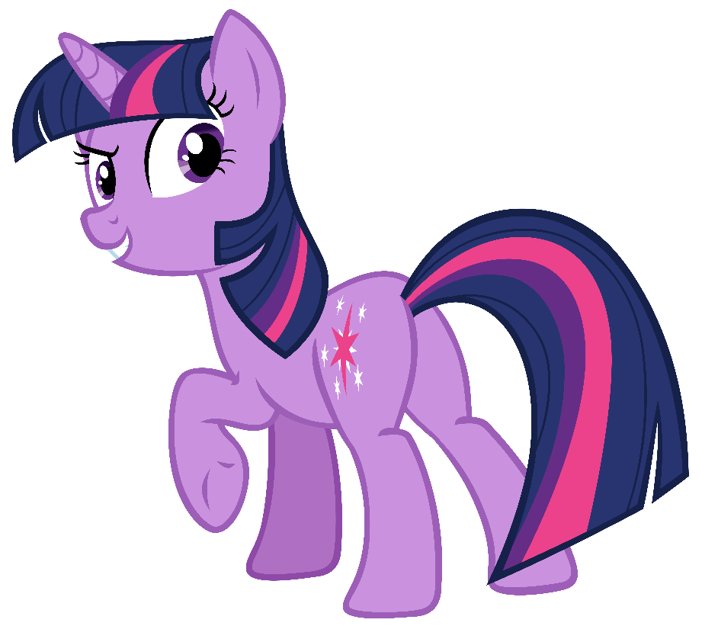
Thanks Udi! That can work but I have a better idea!

Slide 32

…and another one! Thanks Pat!

Slide 33
What happens if you get a duplicate message?

Slide 34
Outbox?

Slide 35

Shipping

Slide 36

Shipping

Slide 37
A
B

Slide 38

You can’t distinguish a duplicate from a retry after failed publish

Slide 39
Layered architectures quickly get messy, you know?

Slide 40

See? Told you it can be simpler than your Outbox

Slide 41
Good for you, but my database has no transactions!

Slide 42

Well, it actually does have some transactions

Slide 43

We need to launch new products to keep up with the competition

Slide 44

You need to make ALL side effects idempotent, not only the state change

Slide 45
Aggregate
Saga

Slide 46






Input
Core
Output

Slide 47
UI
Shell
Shell
Core

